Slide 1

Mortgage Delinquency Dynamics
An In-Depth Analysis with Markov Chain-Based Transition Matrices

Slide 2

Introduction
01

Slide 3
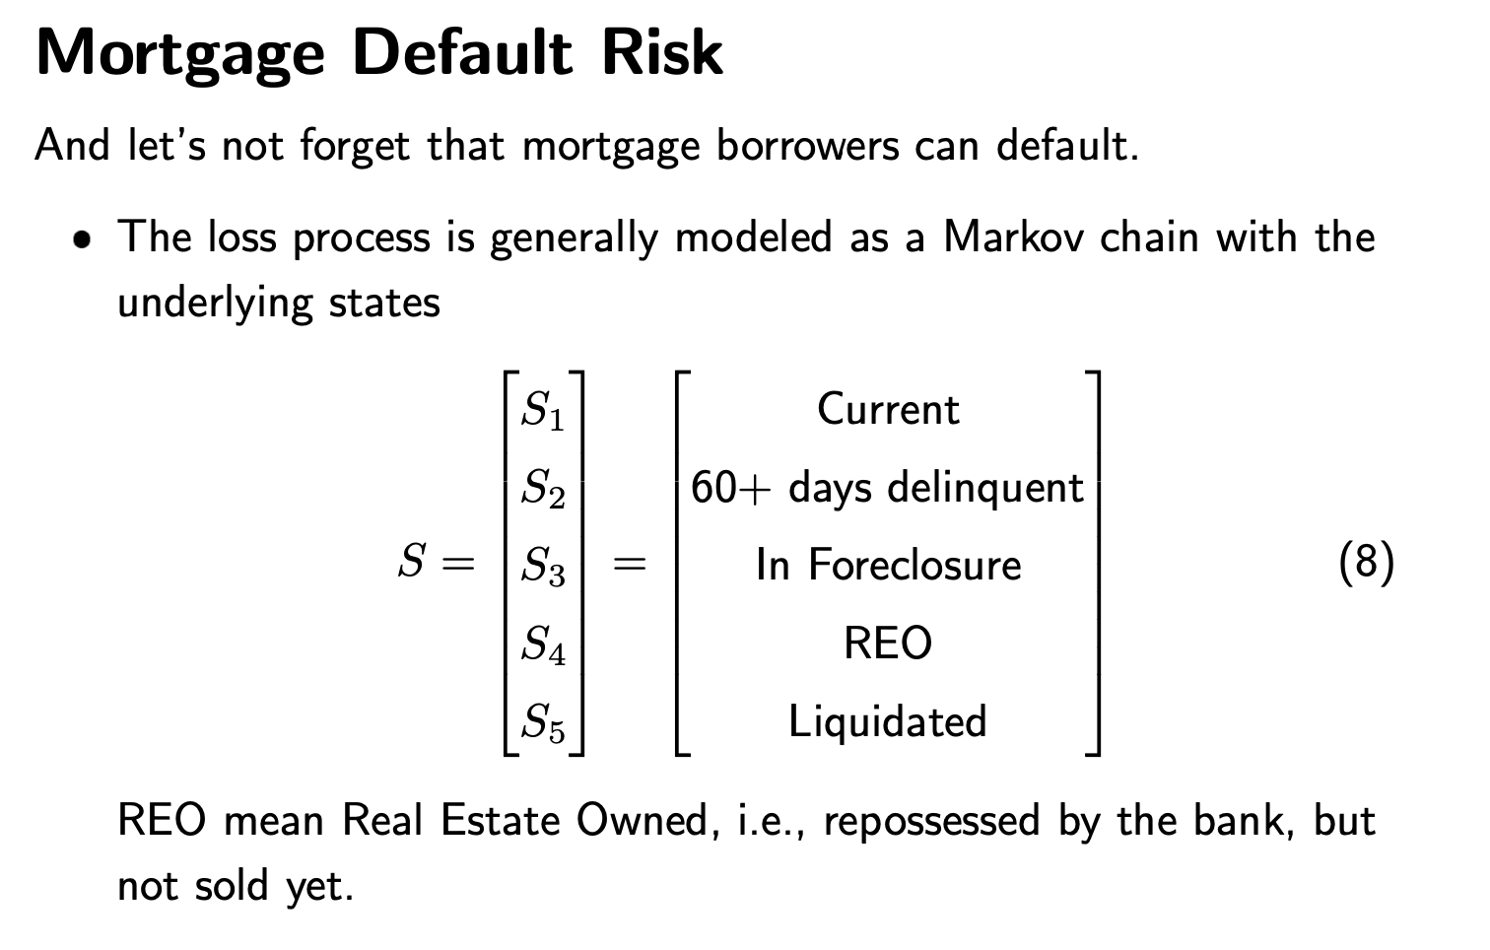
Objectives
To develop a general model for estimating mortgage default risk
Applied Markov chains to capture state transitions of a mortgage
Conditional transition probabilities on both loan-specific and macroeconomic factors

Slide 4

Sample
Prediction
Markov Transition Matrix
Estimates the multi-state default transition matrices.
Uses multinomial logistic regression to systematically predict transitions into default or delinquency states
Incorporates insights from historical borrower- and loan- characteristic data.
Use the estimated beta matrix to predict delinquency transition probabilities on out-of-sample data

Slide 5

02
Data Processing
&
Descriptive Analysis

Slide 6

Data Source
Fannie Mae’s
Sampling
Time Span
Supplementary Data
quarterly data
on single-family mortgage loan performance
over 41.65 million loan data, 2.08 billion performance monthly observations
Jan 1, 2004 - Dec 31, 2022
HPI, Unemployment Rate

Slide 7
Endogenous Variables
Performance
Data
Current Loan-to-Value (LTV) Ratio (covariate)
Debt-to-Income (DTI) Ratio
Borrower’s Original Credit Score
Unpaid Principal Balance (UPB)
Current/ original Interest Rate
Loan Age
Loan modification flag
Loan Purpose (C: cash-out refinance; P:purchase; R: refinance )
Macro
Indicators
HPI &
Lagged 3/6 months HPI
UNEMPLOYMENT &
lagged 3/6 month unemployment

Slide 8
Current loan-to-value ratio (LTV) | Current LTV = (Current UPB/ Original UPB)* (Original HPI/Current HPI) * Original LTV | HPI is the Housing Price Index. This is a covariate variable. | Numerical
Borrower Credit Score at Origination | FICO score | If there are more than two borrowers, the Borrower Credit Score at Origination field will be populated with the primary borrower’s representative credit score. The Co-Borrower Credit Score at Origination field will be populated with the lowest representative credit score of the remaining borrowers, unless the primary borrower’s representative credit score is the lowest of all the borrowers. | Numerical
X8, X9, X10, X11: Unemployment rate of MSA, HPI, Change Of unemployment rate, Change of HPI | In order to consider the delayed effect of unemployment rate and HPI, we introduce two variables: the change of unemployment rate and HPI in the past 6 months, which are also monthly MSA-level data. | These variables can also be indicators for the change of economic condition at that time, which can also have influence on the choice of borrower. | Numerical
X12 Loan purpose | An indicator that denotes whether the mortgage loan is either a refinance mortgage or a purchase money mortgage. Purpose may be the purchase of a new property or refinance of an existing lien (with cash out or with no cash out). | Cash-Out Refinance = C Refinance = R Purchase = P Refinance-Not Specified = U | Categorical

Slide 9
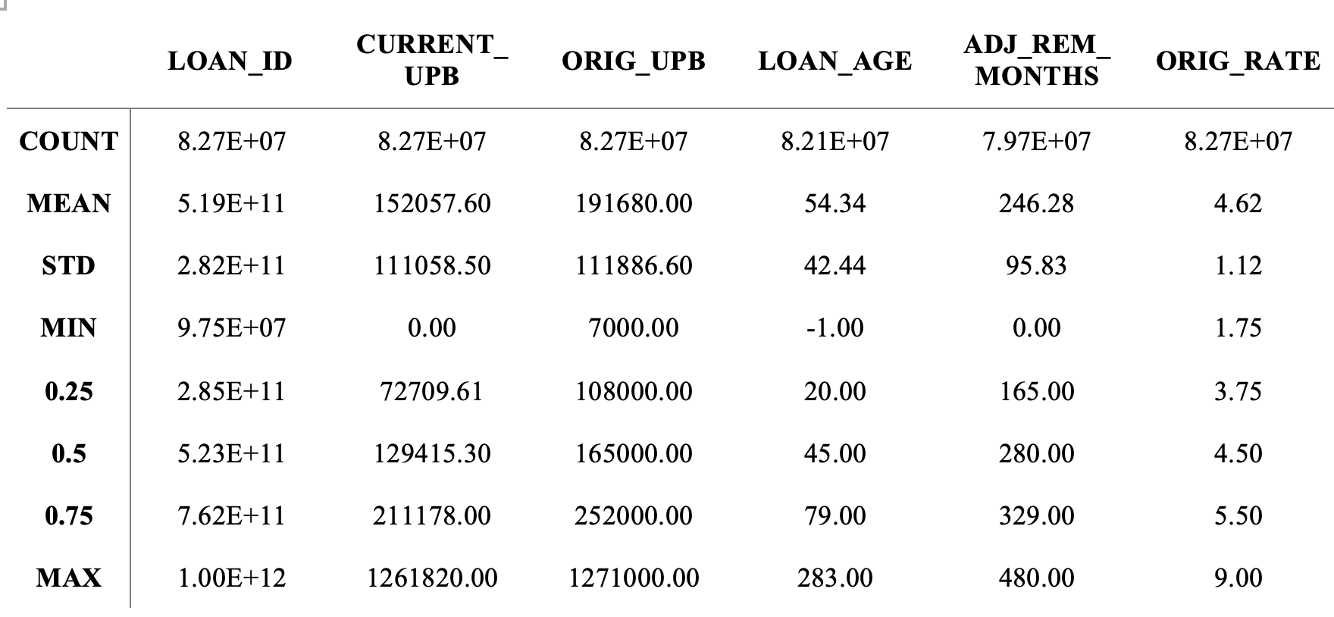
Sample Descriptive Analysis & Standardization (x-mean/std)
Notes:
82,700,000: eighty-two million seven hundred thousand.

Slide 10


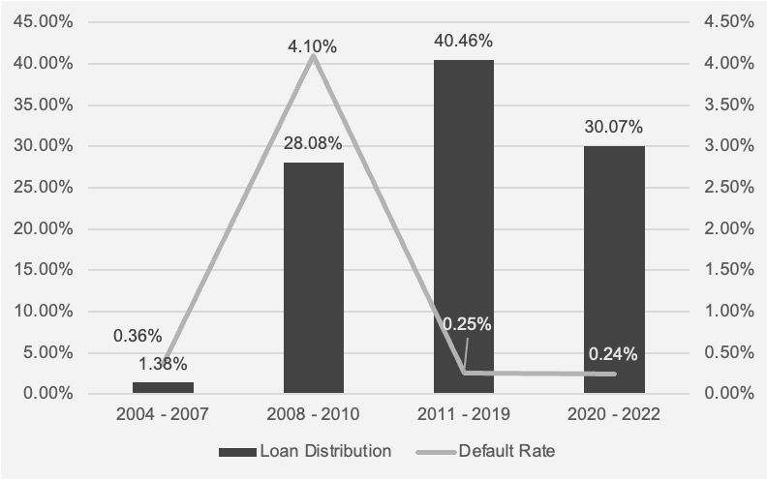
Default Rate
Distribution of Loan and Default Rate at different period

Slide 11
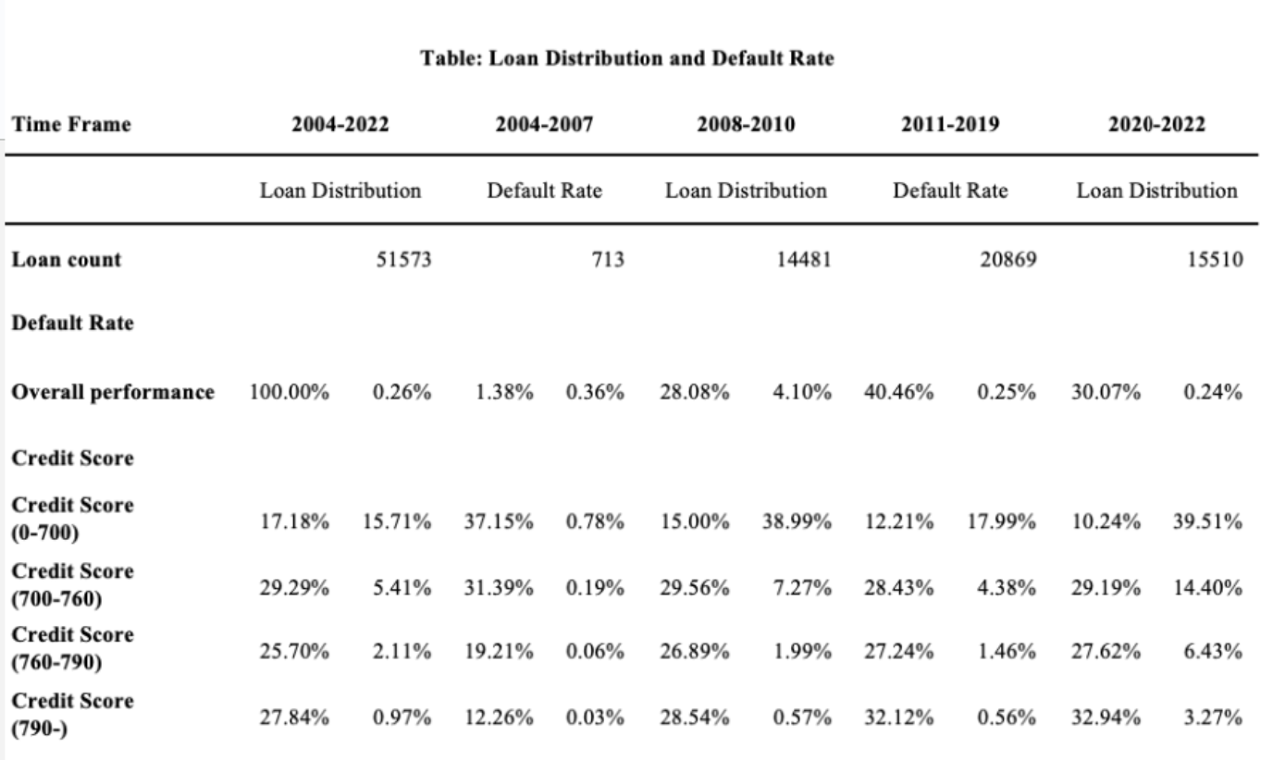
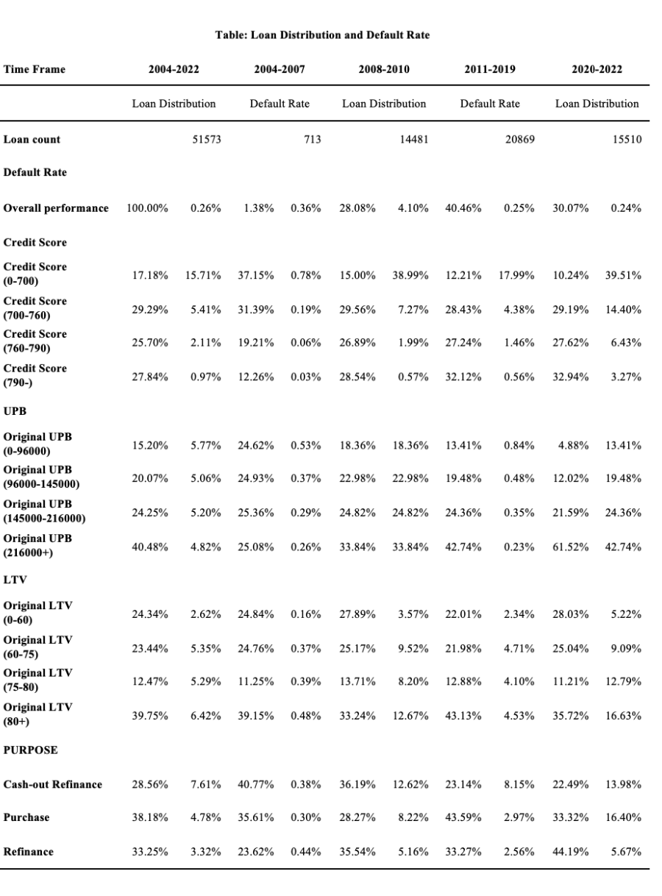

Slide 12
Macro Indicators
Housing Price Index
Unemployment Rate
HPI data resource: Fannie Mae
Frequency: monthly
Time span: from 1975 to 2023
HPI by metropolitan area (MSA code)
Unemployment data resource: Bureau of Labor Statistics (BLS)
Frequency: monthly
Time span: 2000-2023
Unemployment by metropolitan area (MSA code)

Slide 13
Data Sampling
The entire dataset contains over 41.65 million loan data, amounting to approximately 2.08 billion per- formance observations on a monthly basis.
Impossible for a computer to process 200G of data at one time/ Difficult to track data across tables
As a result, we obtained a sampled panel dataset stratified by quarter, containing a lifetime of 1.36 million loans and 82.74 million monthly loan updates.
Original Data (Quarterly Released)
Sampled Loan ID pool
Stratified by quarter
capture the transition dynamic
Sampled data with previous delinquency status
Notes:
We select 5% of the data for each quarter from the original dataset to form a pool of loan IDs. Then, we track all relevant information from the original data based on these loan IDs, creating a sample dataset. This allows us to trace each dynamic data entry and obtain its delinquency data from the previous period.

Slide 14

03
Modeling Methodology

Slide 15
A Markov Chain consists of a series of transitions satisfying the Markov property, that is, the probability of each event depends only on the previous event, and is also known as memoryless property.
Markov Chain
benchmark model
Denote {Zt} as a stochastic process with Markov Property,
P(Zt = zt|Zt−1 = zt−1,...,Z0 = z0) = P(Zt = zt|Zt−1 = zt−1) = pij
Where pij is the transition probability, which can be expressed as a matrix.

Slide 16

This is a simple case……
Time-Homogeneous Markov Transition Model
From the benchmark Markov transition model, the MLE transition probability:
pij = nij / ni
We can derive that:
Zt,t+s = Z0Pij,(t,t+1)Pij,(t+1,t+2)...Pij,(t+s-1,t+s) = Z0(Pij)^s

Slide 17
Conditional Markov Transition
Model
Why extension model?
Markov Property often doesn’t fully apply to real-world economic data.
To solve this problem, the extension model introduces extra covariates, shifting from a strict Markov assumption to a conditional one.
How to apply in context of a mortgage delinquency transition model?
Denote a set of covariates at time t, and denote {Yn} as the delinquency status of a loan in month n:
an extension model
P(Yt = yt|Yt−1 = yt−1,...,Y0 = y0,Xt−1) = P(Yt = yt|Yt−1 = yt−1,Xt−1)

Slide 18
Delinquency status and transition model
01
02
03
04
Current(c)
1 month
delinquent(1)
2 month
delinquent(2)
3 month
delinquent(3)
05
06
07
08
4 month
delinquent(4)
5 month
delinquent(5)
Eight distinct delinquency statuses
Mathematically, we define the discrete Markov transition state space as S = {p, c, 1, 2, 3, 4, 5, d}.
Default(d)
Prepaid(p)

Slide 19
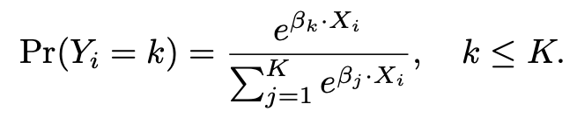
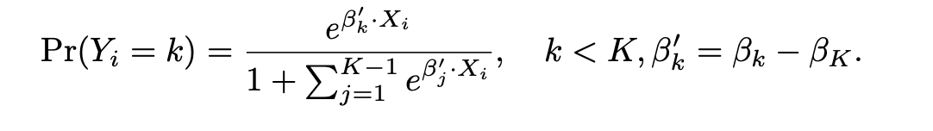
Multinomial Logistic Regression
Multinomial logistic regression model is used in estimating the conditional transition probability. The outcome K is chosen as a the pivot(in our case, that is DLQ_STATUS = 0), we need to do K-1 regressions.
**For those transitions estimated without a model (using only the intercept term), the probability is estimated with p0* = p0/pK

Slide 20
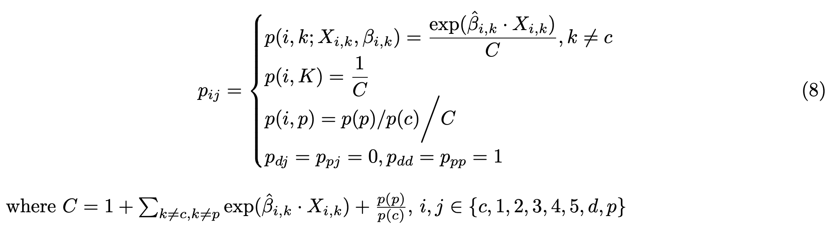
Conditional Transition Probability from state i to state j: Pij
Pjk =
Thus, the Multinomial logistic regression estimates pij can be denote as:

Slide 21

Results
04

Slide 22
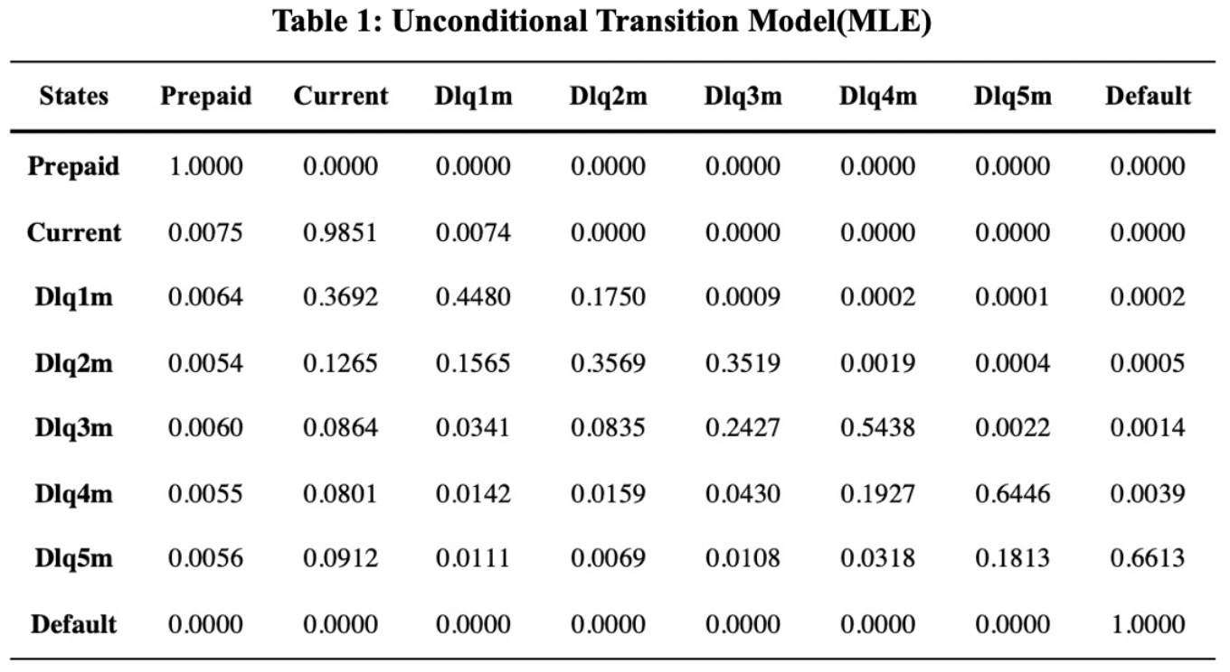
Unconditional Transition Model

Slide 23
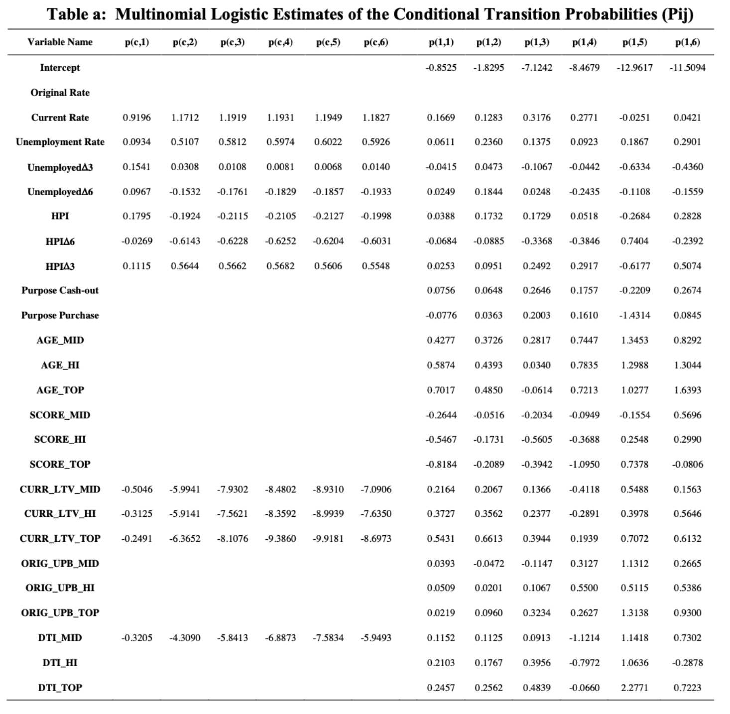
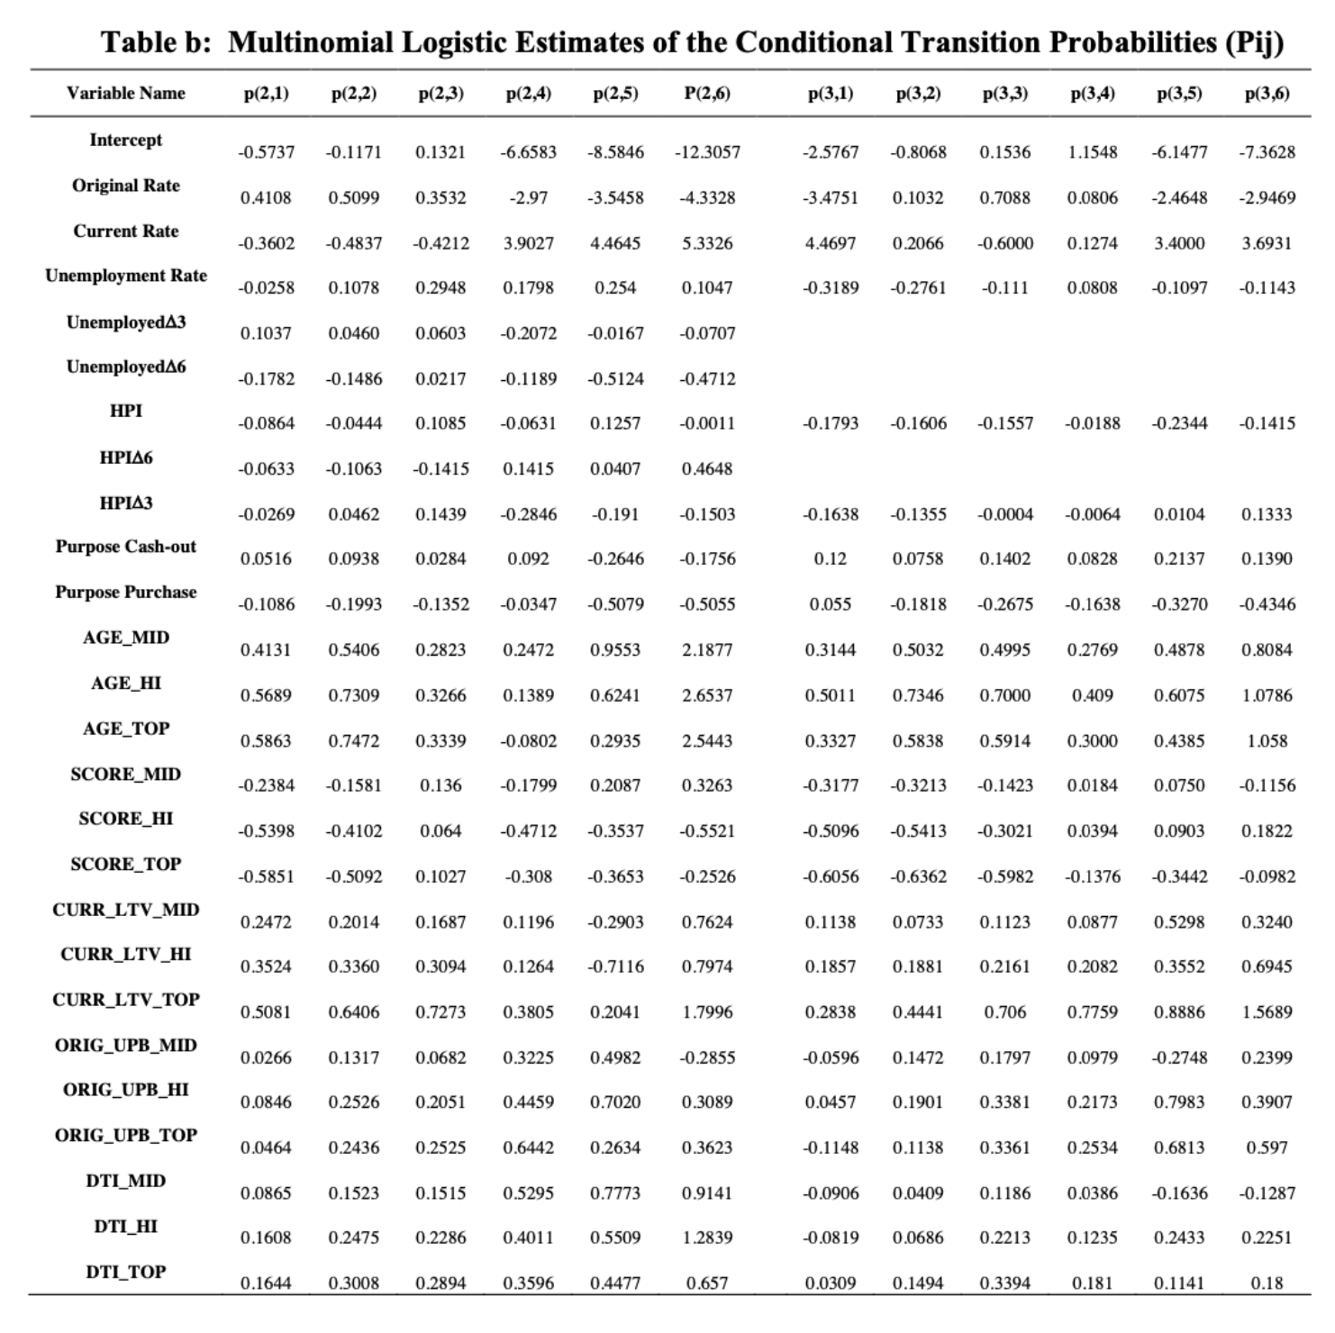
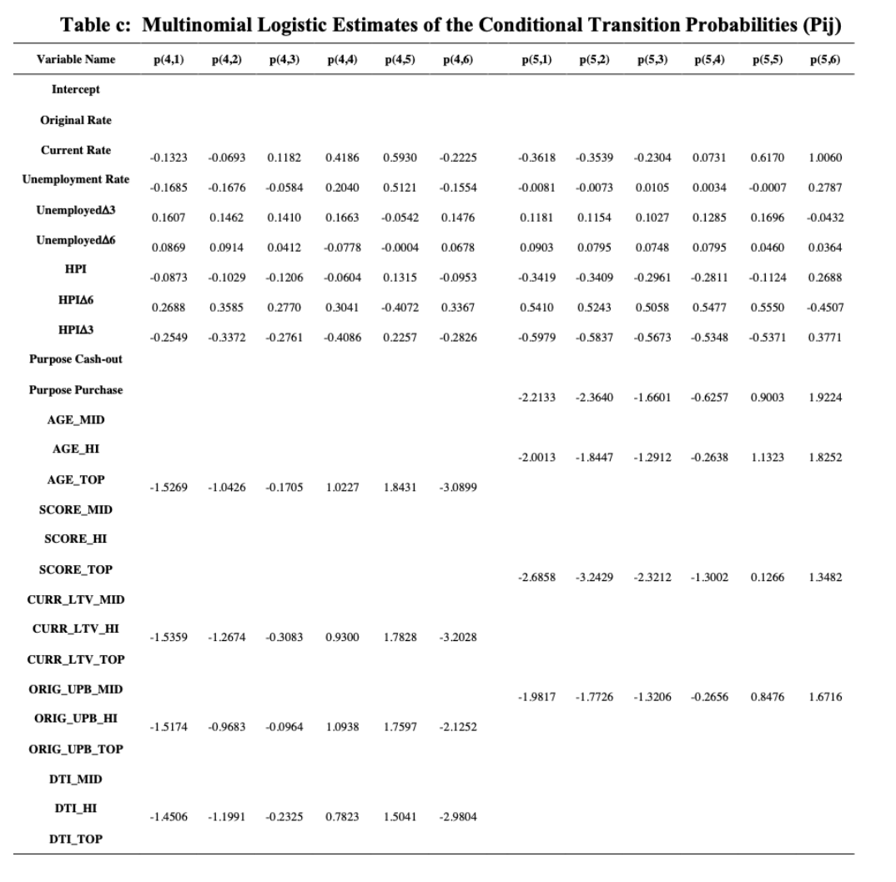
Conditional Transition Model：Results

Slide 24
Conditional Transition Model：Results Explanation(b)
This table shows the part of betas of transition from dlq2m, and ‘current’ state is set as the pivot. Transition from state ‘dlq2m’ to state ‘prepayment’ doesn’t have multinomial logit regression model.
We will next show how to use these betas to calculate the transition probability.

Slide 25
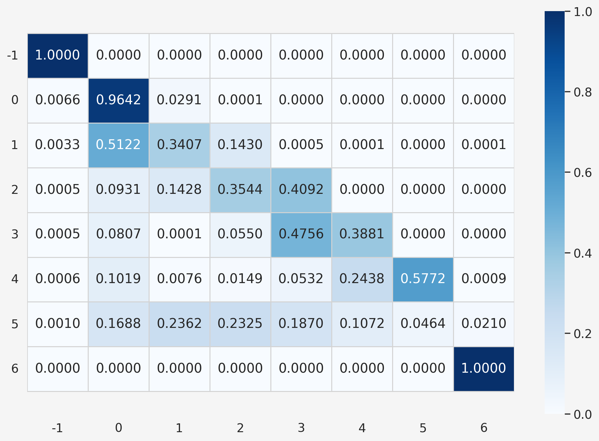
Estimate Transition Probability with data:
Suppose we have the following values of covariates (out-of-sample data point in 2023), we can generate a transition probability matrix, where -1 is prepaid, and 6 is default
ORIG_RATE -1.109147
CURR_RATE -1.955411
DLQ_STATUS 6.000000
MOD_FLAG 1.000000
UNEMPLOY -1.545710
UNEMPLOY_L3 0.312905
UNEMPLOY_L6 -0.052274
HPI 1.216603
HPI_l6 -0.109124
HPI_l3 0.232609
PURP_C 0.000000
PURP_P 0.000000
AGE_MID 1.000000
AGE_HI 0.000000
AGE_TOP 0.000000
SCORE_MID 1.000000
SCORE_HI 0.000000
SCORE_TOP 0.000000
CURR_LTV_MID 0.000000
CURR_LTV_HI 1.000000
CURR_LTV_TOP 0.000000
ORIG_UPB_MID 0.000000
ORIG_UPB_HI 1.000000
ORIG_UPB_TOP 0.000000
DTI_MID 0.000000
DTI_HI 0.000000
DTI_TOP 1.000000
Const 1.000000

Slide 26

05
Insights

Slide 27

Model Improvement
Exploration of the Temporal Shift of Beta
Sub time range MNL, increase the explanatory power of the model
Higher Order Markov Model
Include the covariates and delinquency status of more past periods
Model Variation
Different models for the same starting state
Deeper application of MNL
Our Model: State Transition Matrix
The state transition matrix based on Markov and multinomial logistic regression
Unconditional State Transition Probability Matrix
Commonly used in practice

Slide 28

Thank You!
Liangqi An, Yifan Dong, Mengjia Tan, Tianyun Tan, Ruoshan Wang, Zelong, Zhang

